Slide 1
ASIA RELIGIOUS AND ETHNIC FREEDOM AWARD
Project Results
Date: May 27, 2025
Implementing partners: Freedom House, Search for Common Ground, Pact, Internews, American Bar Association Rule of Law Initiative
Notes:
Welcome to Asia REF! In this slide deck you will find a brief introductory guide to the award each new project is a part of

Slide 2
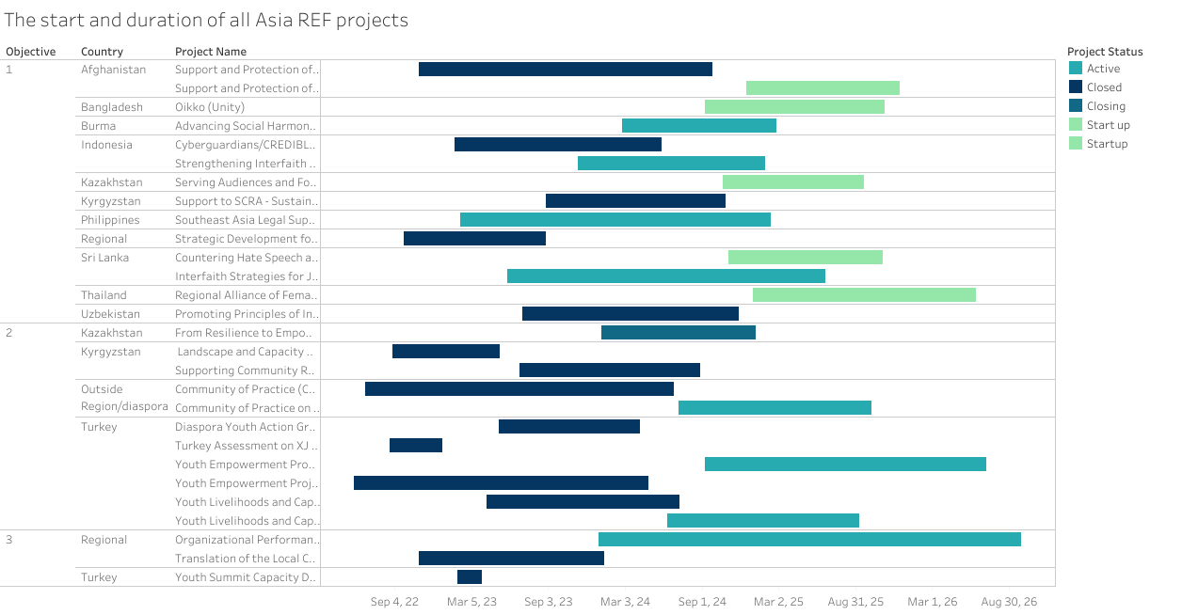

Slide 3
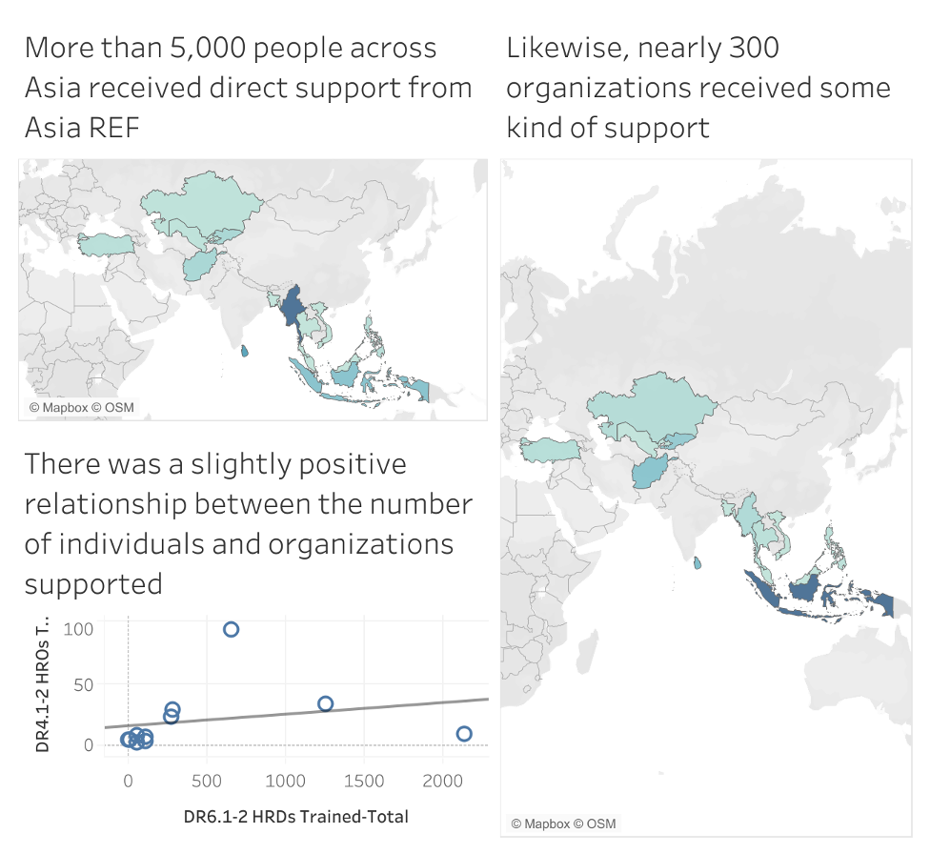
Individuals and Organizations supported by Asia REF
Over the life of the program, Asia REF reached a substantial number of human rights defenders and human rights organizations.
One theory at the beginning of the award was that the projects would be able to invest in countries where there was greatest need. Ultimately, other factors—including the possibility of scaling work—contributed to this more.
However, one outlier is worth noting. In Myanmar, the ASH project was able to have an outsize impact despite active conflicts, supporting around 1,000 hrds in the country.

Slide 4
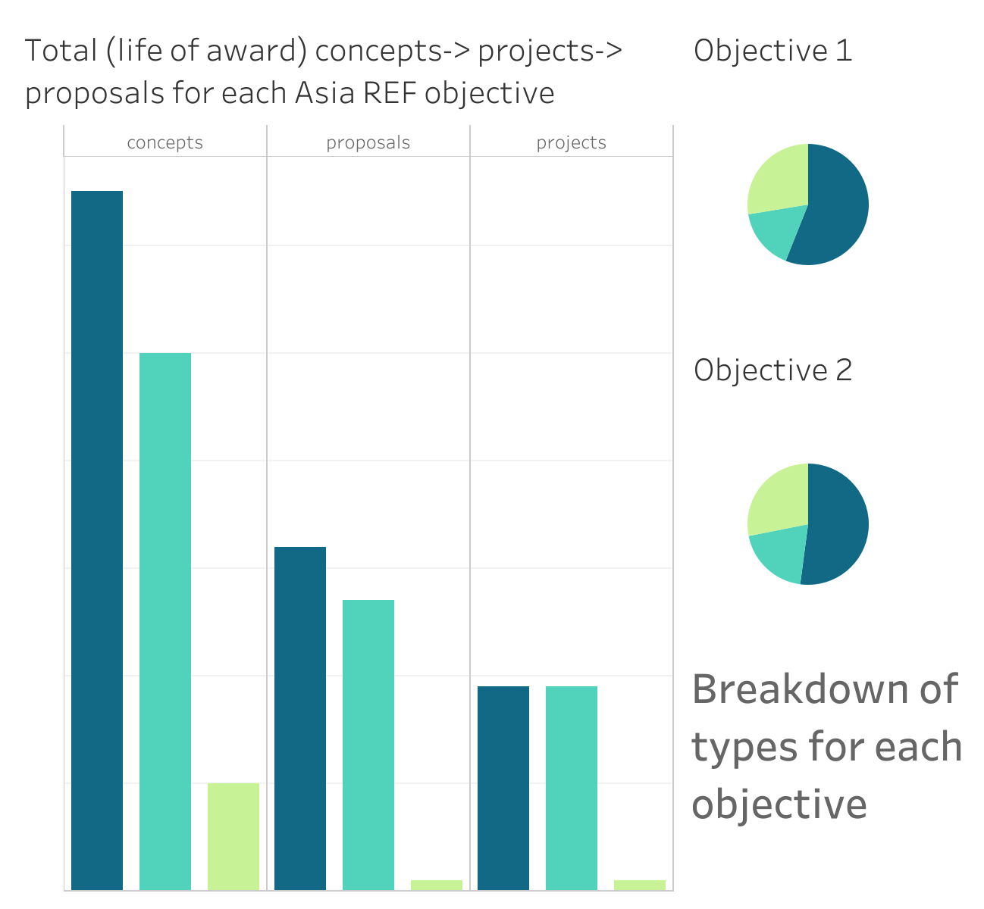
Asia REF Projects by Objective
Objective 1. Support targeted in-country and cross-border efforts by local partners to expand the freedom of religion and conscience in Asia
Objective 2. Promote the international religious freedom of China’s minority diaspora populations located in nearby or neighboring countries that have been subject to human rights violations
Objective 3. Improve local community partners, including religious and ethnic minority community partners, capacities.

Slide 5
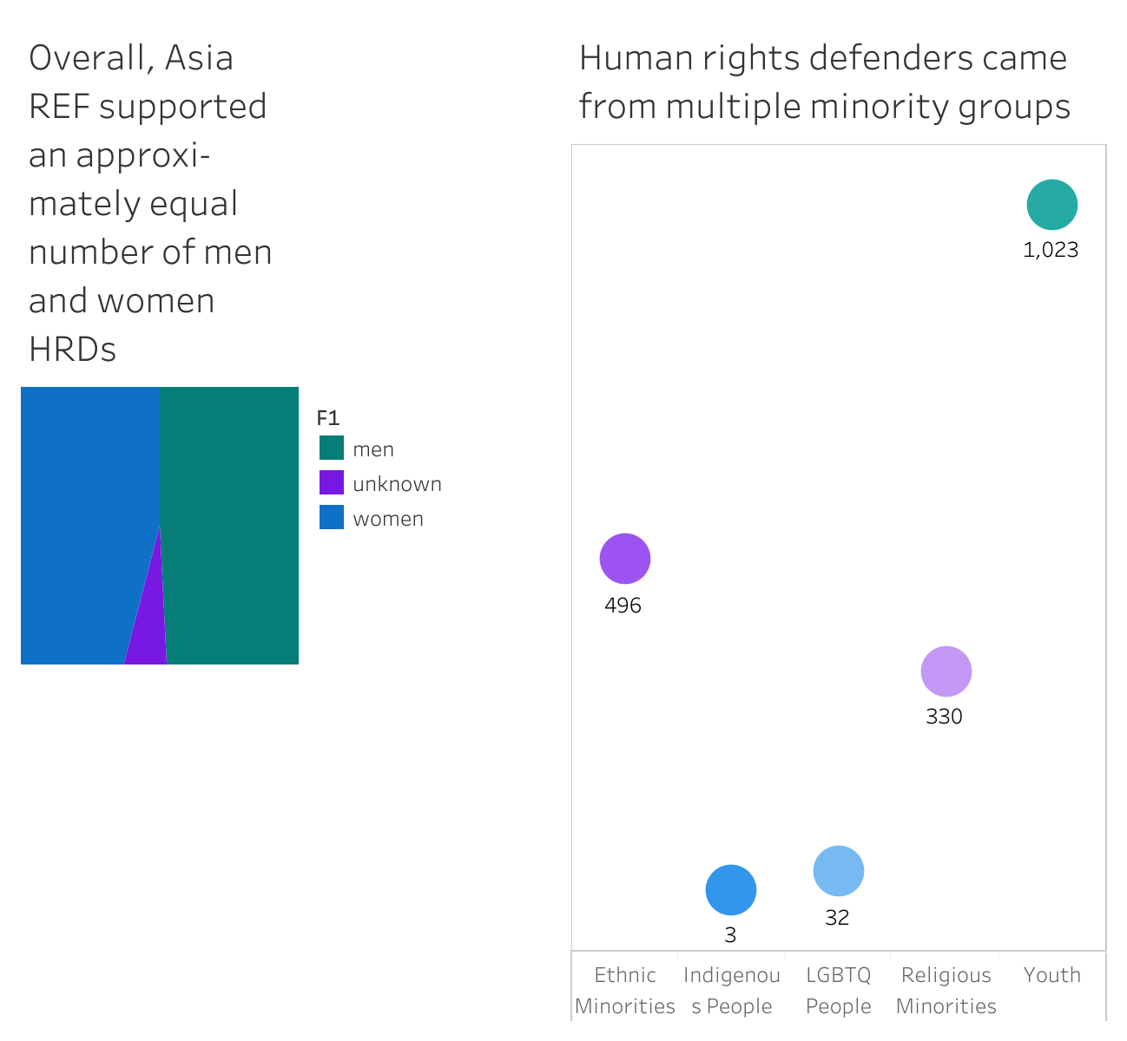
Supporting diverse populations
While Asia REF did not set out to be a youth-focused project, during implementation we learned that youth are the most likely to be engaged in religious and ethnic freedom activities.
The project was, however, able to still have significant impact supporting other minority groups, particularly religious and ethnic minorities.
Finally, following the first year of implementation, we learned that there was a substantial gender gap. By the time of termination, this gap was substantially narrowed.

Slide 6
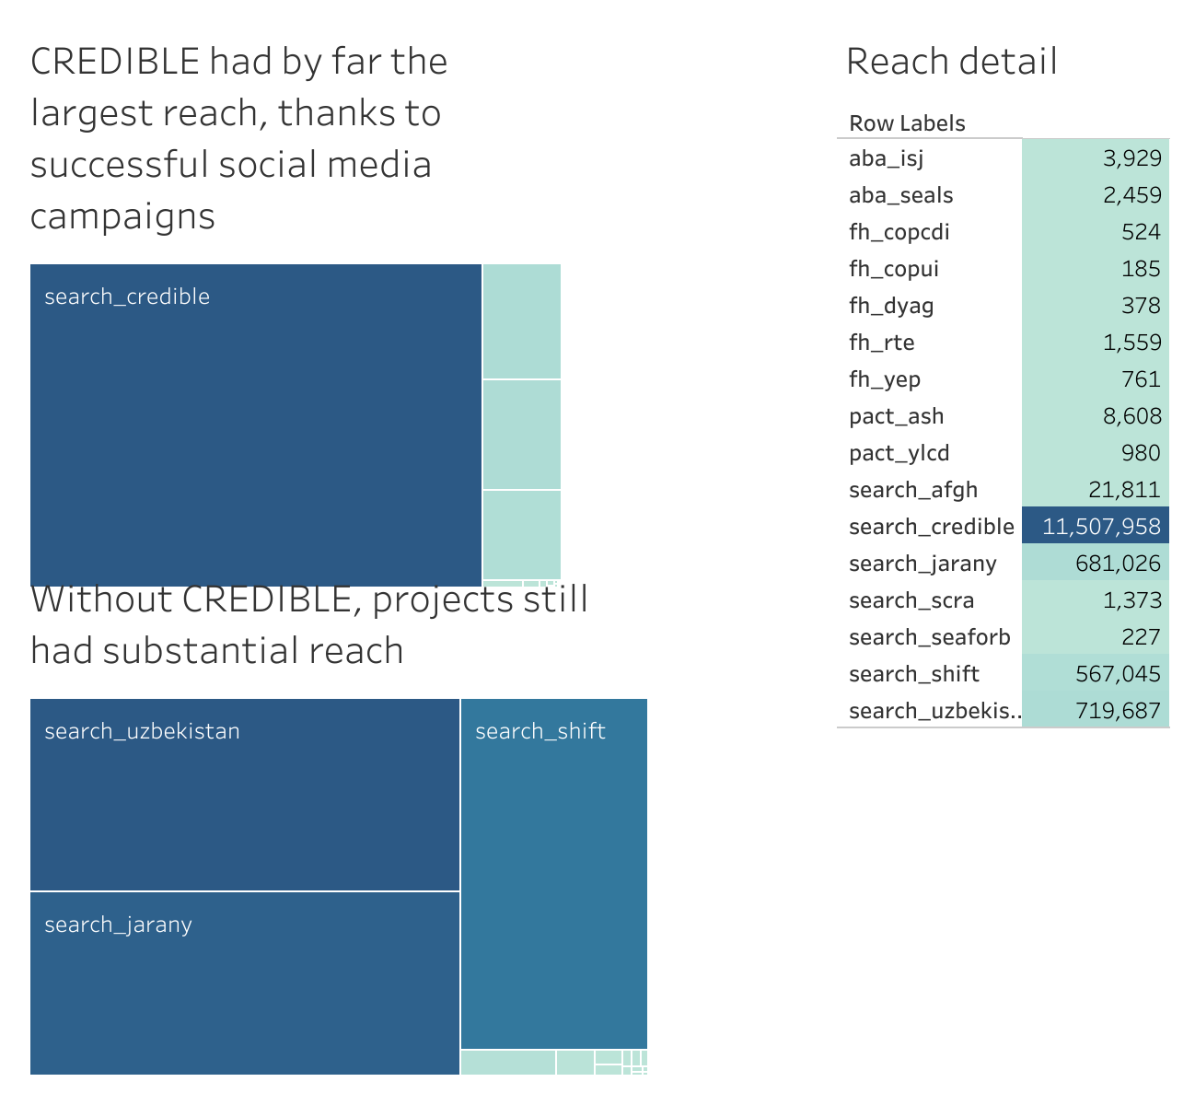
Asia REF’s reach far exceeded its grasp
Thanks in large part to social media-focused programs in Indonesia, Uzbekistan, and Kyrgyzstan, Asia REF was able to reach a substantially larger audience through indirect means.
Beyond direct support through trainings and workshops, Asia REF projects used social media engagements, community outreach, and other means to share messages around social cohesion and tolerance.
In total, Asia REF reached 13.5 million people across the continent in the three and a half years of implementation.

Slide 7
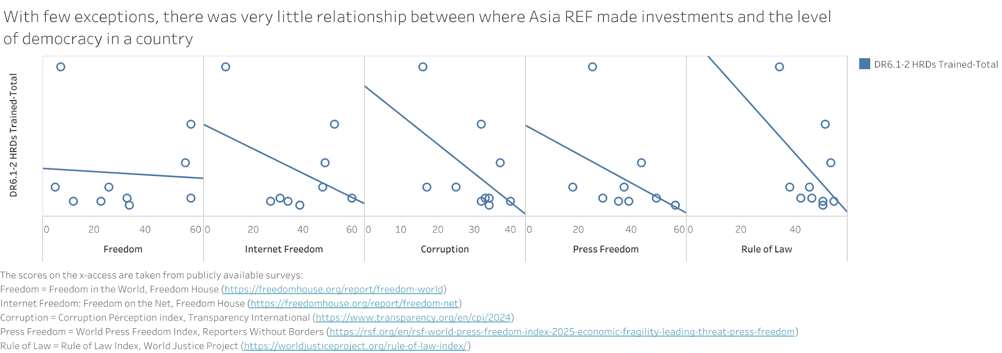
Was Asia REF able to invest resources in the least democratic countries?
Thanks to the outlier of Afghanistan, there is a much stronger implied relationship than was actually observed. While Asia REF made strides in working in difficult contexts, more work needs to be done to advance FORB where it is needed the most.

Slide 8
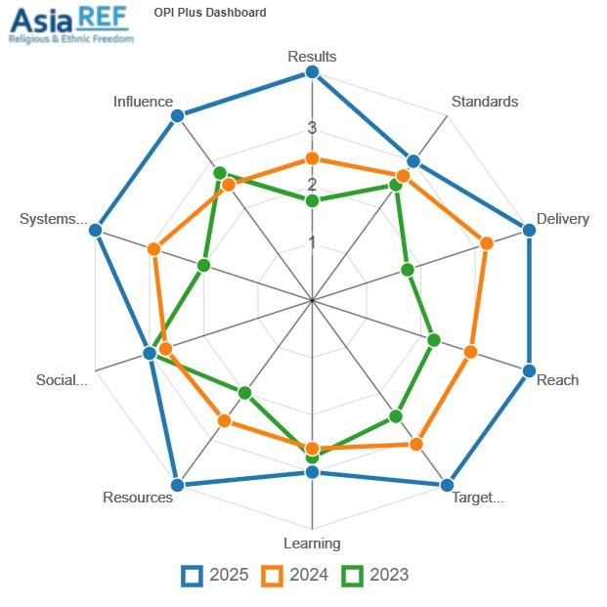
Our partners grew in their ability to achieve their missions.
In addition to the project work, Asia REF set aside specific funds and activities designed to work with partners, articulate growth goals, and provide mutual support to achieve this.
With the support of Pact’s Organizational Performance Index, capacity development was understood though specific domains.
With the exception of just one, from 2023 to 2025, all partners participating in capacity strengthening reported improvement in all domains.

